Slide 1
Lab 12
Finite State Machines

Slide 2
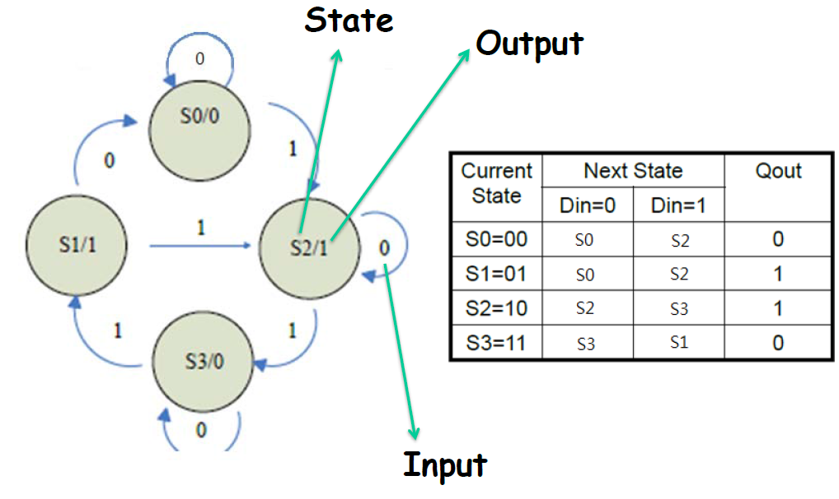
MOORE MACHINE
Moore machine: outputs depend only on the current state of the circuit

Slide 3
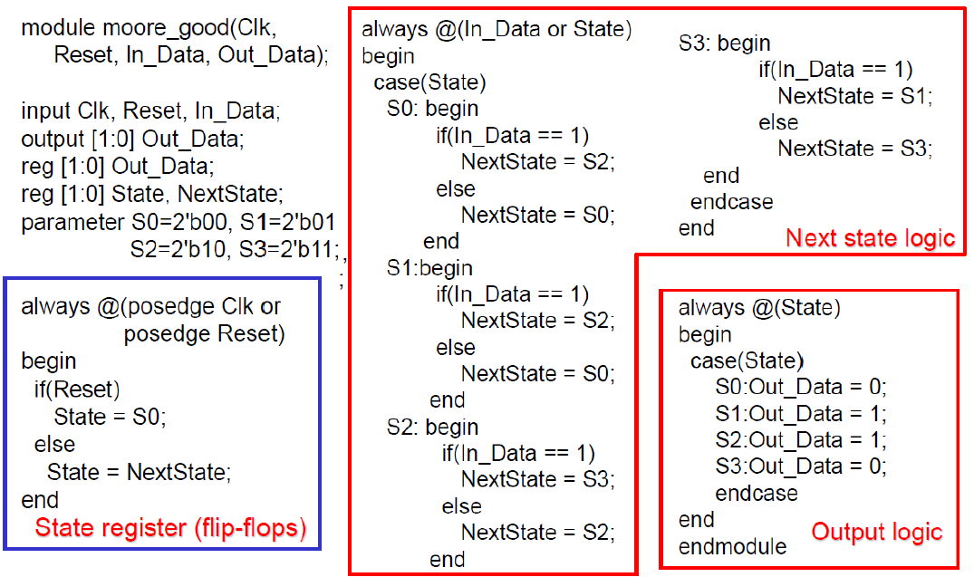
MOORE MACHINE: VERILOG CODE

Slide 4
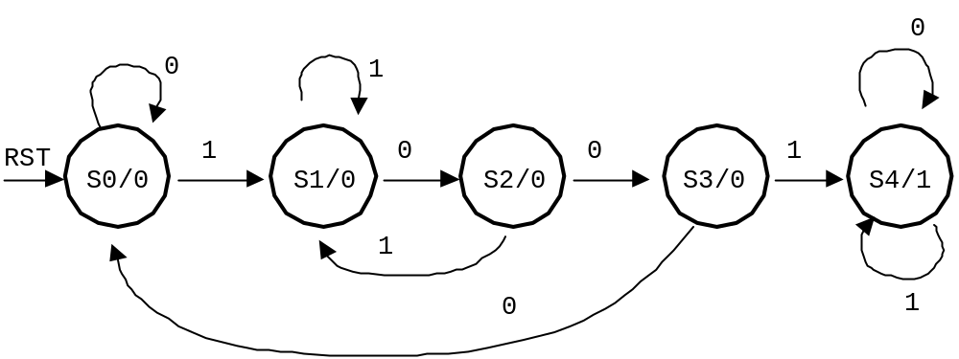
DESIGN EXAMPLE 1
a sequence recognizer that has an input x and an output op.
Output op=1 when the previous four values of x were 1001, and op stays at 1 until reset button is pressed; otherwise op=0.

Slide 5
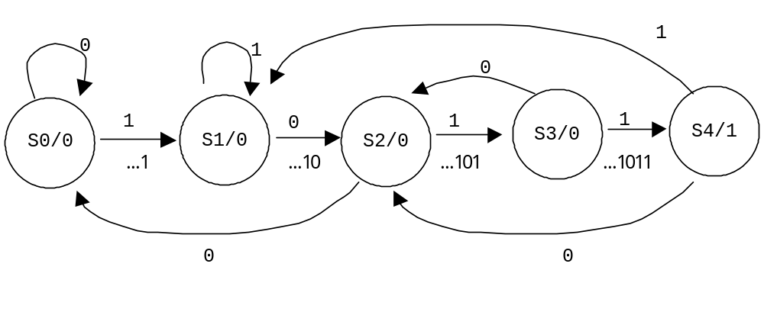
DESIGN EXAMPLE 2
a sequence recognizer that has an input x and an output op.
Output op=1 when the previous four values of x were 1011;
otherwise op=0.

Slide 6
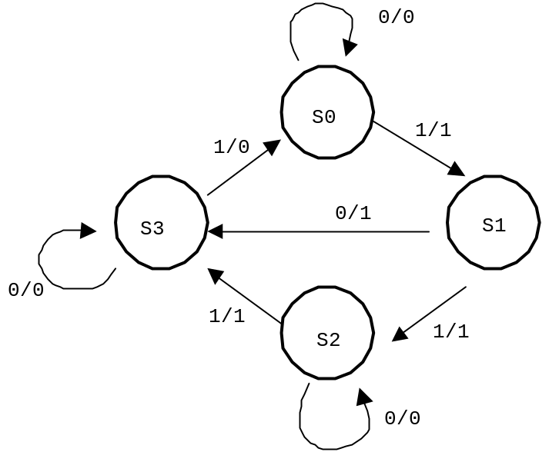
MEALY MACHINE
Mealy machine: outputs depend both on the current state and primary inputs of the circuit.
現態
次態
輸出
X=0
X=1
X=0
X=1
S0
S0
S1
0
1
S1
S3
S2
1
1
S2
S2
S3
0
1
S3
S3
S0
0
0

Slide 7
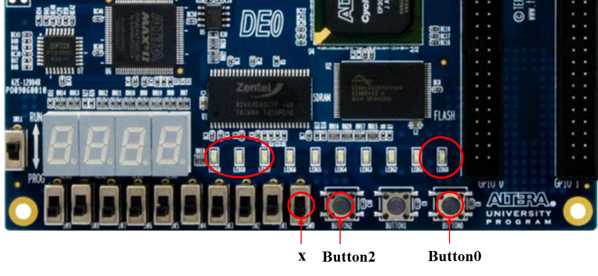
EXPERIMENT STEP (1):
Design a sequence detector(I).
With reference to the design example specified on page 5, implement it on DE0 as follows,
Use SW0 as input x, LEDG0 as the output op, and LEDG7-9 to represent present state.
Use Button0 as an active-low asynchronous reset, and Button2 as a clock input.

Slide 8
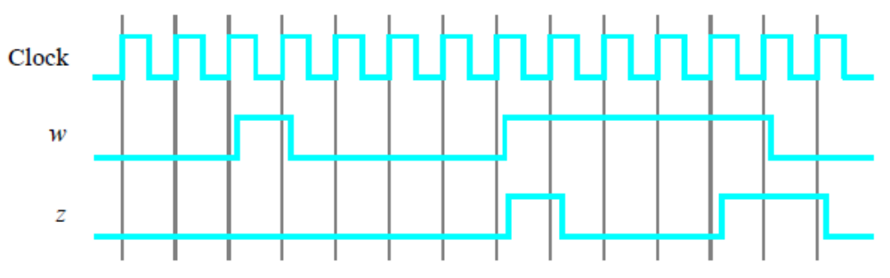
EXPERIMENT STEP (2):
Design a sequence detector(II).
We wish to implement a Moore machine that recognizes two specific sequences of applied input symbols, namely four consecutive 1s or four consecutive 0s. There is an input w and an output z. Whenever w = 1 or w = 0 for four consecutive clock pulses, the value of z has to be 1; otherwise, z = 0.
Overlapping sequences are allowed, so that if w = 1 for five consecutive clock pulses the output z will be equal to 1 after the fourth and fifth pulses. Figure 1 illustrates the required relationship between w and z.
Figure 1: Required timing for the output z.

Slide 9
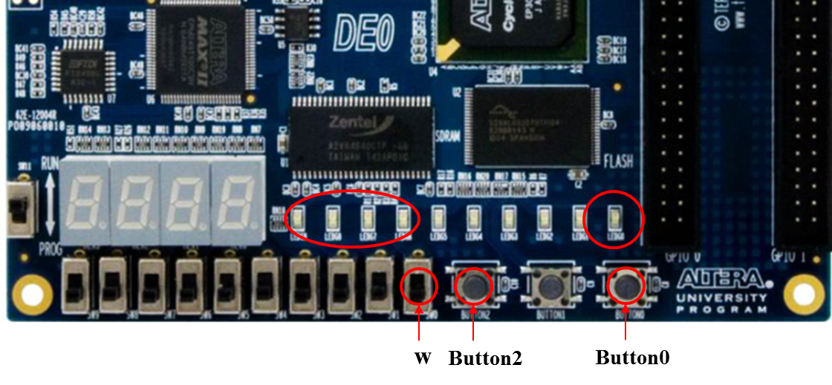
EXPERIMENT STEP (2):
Design a sequence detector(II).
Use SW0 as input w, LEDG0 as the output z, and LEDG6-9 to represent present state.
Use Button0 as an active-low asynchronous reset, and Button2 as a clock input.

